Slide 1
Messages : Bright Vs Dark side
The messages that are both ethical and appropriate as bright side messages.
Dark side messages are unethical and/or inappropriate.
Hard dark side messages are somewhat ethical and unethical because they are honest, but also potentially damaging to the relationship.
Easy dark side messages are somewhat ethical and unethical because they are dishonest in order to maintain a good relationship.
Evil dark side messages are both disrespectful and damaging to the relationship.

Slide 2
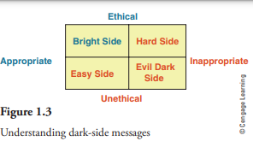
Example
Bright side response: "Wow, Sarah, your artwork is so unique and vibrant! I can tell you put a lot of creativity and passion into it, and it's truly inspiring."
Hard dark side response: "Sarah, your artwork is quite different from what I expected. I've always admired your previous pieces, but this one doesn't resonate with me as much. Perhaps it will grow on me over time."
Easy dark side response: "Sarah, your artwork looks nice."
Evil dark side response: "Sarah, your artwork is honestly terrible. It's clear you have no talent, and I can't believe you wasted your time on something so awful."

